Slide 1



Molecular Simulation using Machine Learning Interatomic Potentials
EXPLORING THE DEEPMD-KIT FRAMEWORK | Bachelor Thesis Project (JULY - NOV 2025)
Student: Vanshita Bihani (Roll No. 220107093)
Supervisor: Prof. Amit Kumar
Department of Chemical Engineering, IIT Guwahati

Slide 2

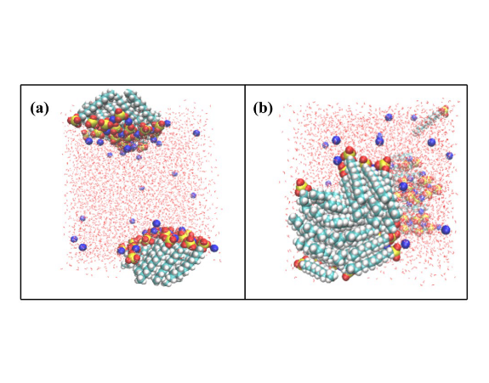
Problem Statement
Domain: Molecular Dynamics (MD) simulations for predicting material properties at the atomic scale.
Current Challenge: The trade-off between efficiency and accuracy.
Classical Force Fields are fast but chemically inaccurate.
Ab Initio MD (AIMD) is accurate but computationally prohibitive (O(N^3)).
Scope: Validate Deep Potential (MLIP) to bridge this gap, using Methane (CH4) as a case study for stiff bonds and weak dispersion.

Slide 3





Background & Motivation
Current Practice
Why Insufficient?
The Use Case
Researchers rely on Classical Force Fields (AMBER/CHARMM) for large systems or AIMD for small, reactive clusters. Neither scales well for accurate transport properties.
Classical models cannot capture bond breaking or polarization. AIMD is limited to picoseconds, failing to capture diffusion and thermal conductivity in bulk liquids.
Methane (CH4) is challenging: it has stiff intramolecular covalent bonds requiring quantum accuracy, but interacts inter-molecularly via weak Van der Waals forces.

Slide 4

Project Objectives
Theoretical Foundation: Review the evolution from empirical Force Fields to Neural Network Potentials.
Implementation: Establish a "Data-to-Discovery" pipeline using DeepMD-kit for training and LAMMPS for simulation.
Validation: Assess the model's accuracy on Methane's structural (bond length) and transport properties (Diffusion, Conductivity).
Primary Objective: Demonstrate that Deep Potential can bridge the gap between quantum accuracy and classical efficiency for complex fluids.

Slide 5
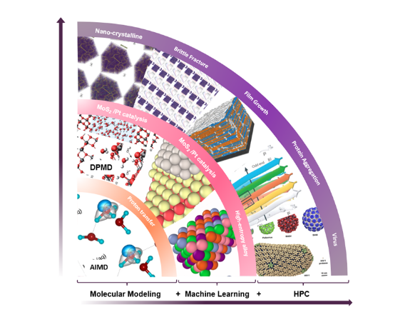

Literature Review: Existing Approaches
Evolution of Potentials
•
Classical (AMBER/CHARMM): Efficient (O(N)), but rigid and non-reactive.
•
Reactive (ReaxFF): Handles chemistry, but requires complex parameter fitting.
•
Neural Networks (BPNN/DP): Learn the Potential Energy Surface directly from quantum data.
Selection: We chose DeepPot-SE (Deep Potential Smooth Edition) because it offers the optimal balance of accuracy and inference speed required for nanosecond-scale transport simulations.

Slide 6

Methodology: Overall Workflow
1. Data Acquisition
3. Compression
Collect high-fidelity Ab Initio (DFT) data for atomic configurations (Energies & Forces).
Compress the trained model graph to accelerate inference speed for MD.
2. Model Training
4. MD Simulation
Train DeepPot-SE model using DeepMD-kit to map descriptors to potential energy.
Run large-scale simulations in LAMMPS to calculate transport properties.

Slide 7

Methodology Details
DeepPot-SE Architecture
Simulation Setup
The model uses an Embedding Network to transform local atomic environments into symmetry-invariant descriptors. A Fitting Network (ResNet) then maps these descriptors to atomic energies. This ensures the potential is smooth and continuous.
Integrator: Velocity Verlet with 0.1 fs timestep (for fast C-H vibrations).
Diffusion: Calculated via Einstein Relation (Mean Square Displacement).
Conductivity: Calculated via Green-Kubo relations (Heat Flux Autocorrelation).

Slide 8
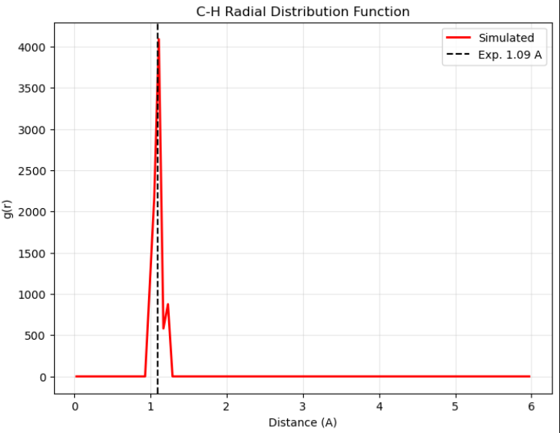
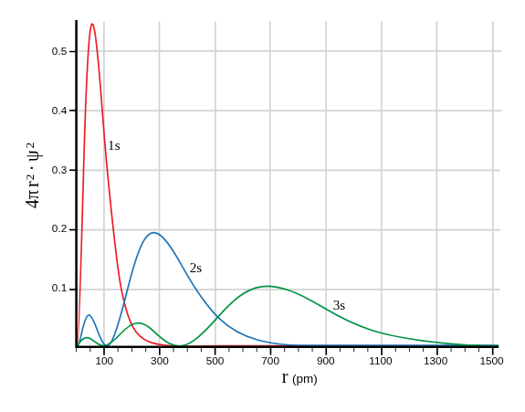
Results: Structural Validation (Case Study)
Model Accuracy
Energy RMSE: 0.92 meV/atom (Chemical accuracy).
Force RMSE: 121 meV/Å (Sufficient for dynamics).
Microscopic Structure
The Radial Distribution Function (RDF) shows a sharp peak at 1.1 Å, matching the experimental C-H bond length of 1.09 Å. The model learned the "stiff spring" nature of the bond without explicit harmonic parameters.

Slide 9
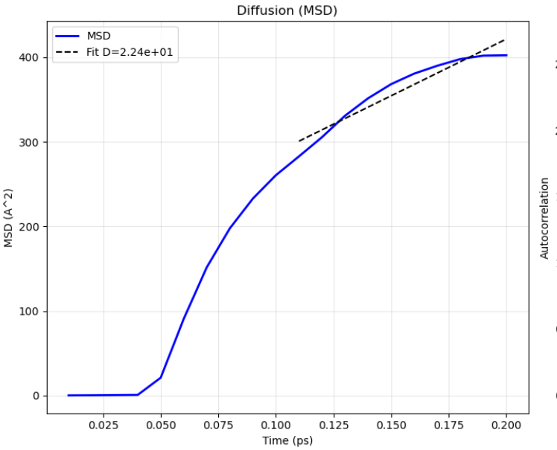
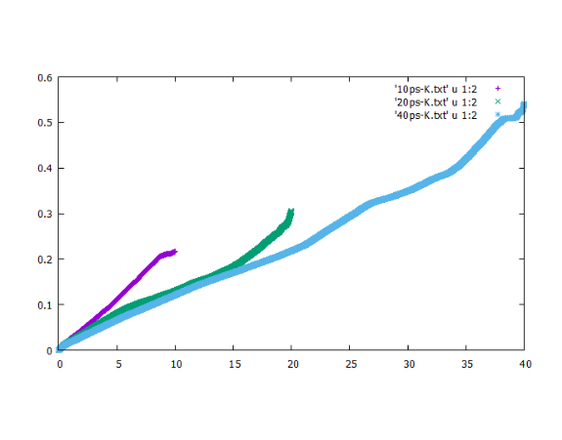
Results: Transport Properties & Insights (Case Study)
Macroscopic Agreement
Self-Diffusion Coefficient (D):
~2.3 nm^2/s
This is remarkably close to the experimental value of 2.6 nm^2/s.
Key Insight
The Deep Potential model successfully captured weak intermolecular dispersion forces in the dense liquid phase, a property usually requiring complex Lennard-Jones tuning, while maintaining quantum accuracy.

Slide 10
Conclusions & Future Work
Conclusions
Future Work (BTP-II)
•
Successfully established a data-to-discovery pipeline using DeepMD-kit.
•
Active Learning: Implement the DP-GEN loop to automate data exploration.
•
Complex Systems: Extend simulations to natural gas mixtures (CH4/C2H6) or interfaces.
•
Validated the model on Methane, reproducing both microscopic bond lengths and macroscopic transport coefficients.
•
•
Reactivity: Attempt high-temperature combustion simulations to test bond breaking.
Demonstrated that MLIPs can achieve "AIMD-quality" results at nanosecond timescales.

Slide 11
Thank You ☺

